Slide 1

Machine Learning Models and Applications
Dr. Venkataramana Veeramsetty
Associate Professor, School of CS & AI
Director @ Center for AI and Deep Learning
SR University

Slide 2
Contents
Human Learning Vs. Machine Learning
Components of Machine Learning
Type of Problems
Machine Learning Models
Structure of Machine Learning Projects

Slide 3
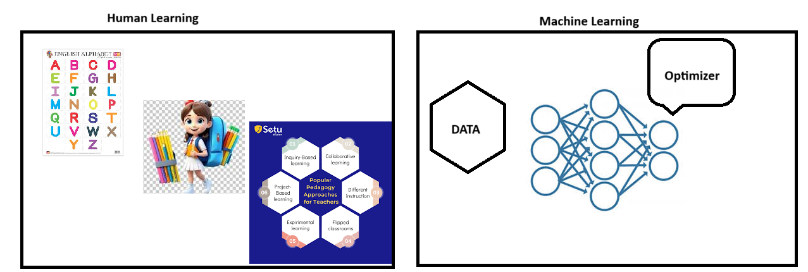
Human Learning Vs. Machine Learning

Slide 4
Components of Machine Learning
Machine Learning Model
Data
Optimizer or Algorithm

Slide 5
Types of Real Time Problems
Regression
Classification
Clustering

Slide 6
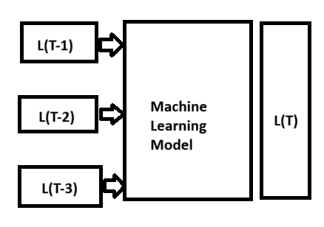
Regression Problems
Used to predict a continuous dependent variable based on a single independent variable.

Slide 7
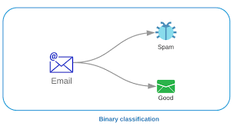
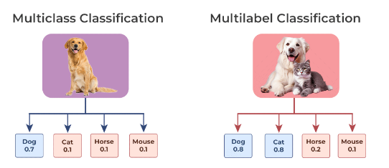
Classification Problems

Slide 8
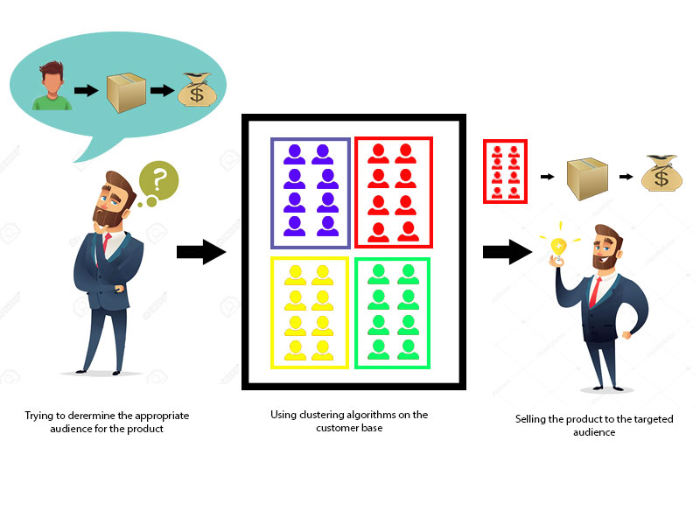
Clustering Problems
Clustering helps to splits data into several subsets. Each of these subsets contains data similar to each other, and these subsets are called clusters.

Slide 9
Type of Algorithms
Supervised Learning
Unsupervised Learning
Reinforcement Learning

Slide 10
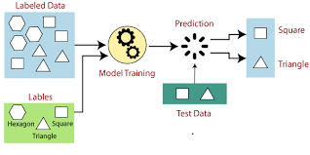
Supervised Learning
In supervised learning both input features and target labels are required

Slide 11
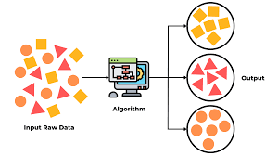
Unsupervised Learning
Required only input features

Slide 12
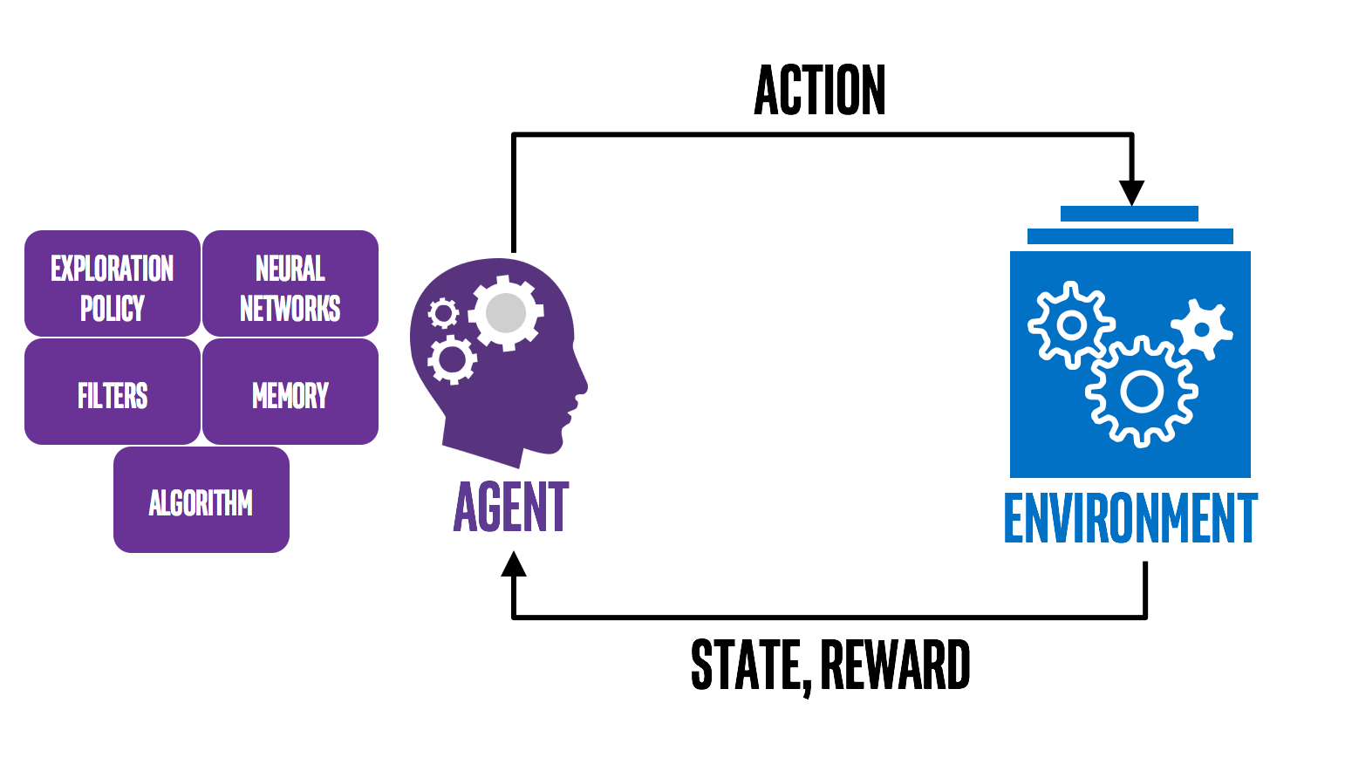
Reinforcement Learning
Reinforcement Learning is a subfield of machine learning that teaches an agent how to choose an action from its action space, within a particular environment, in order to maximize rewards over time.

Slide 13
Machine Learning Models - Regression
Linear Regression
Decision Tree
Random Forest
Support Vector Machine
Neural Networks

Slide 14
Machine Learning Models - Classification
Logistic Regression
Decision Tree
Random Forest
Support Vector Machine
Neural Networks
K-nearest neighbors (KNN)
Naïve Bayes Classifier

Slide 15
Machine Learning Models - Clustering
Neural Networks
K-Means
DBSCAN clustering algorithm
OPTICS algorithm

Slide 16
Structure of Machine Learning Projects
Understand Problem Statement
Data Collection
Data Preprocessing
Missing Value Treatment
Outlier Treatment
Normalization (Optional)
Data Split
Identify of Machine Learning Models
Machine Learning Model Training
Machine Learning Model Testing

Slide 17

Thank You

